Slide 1
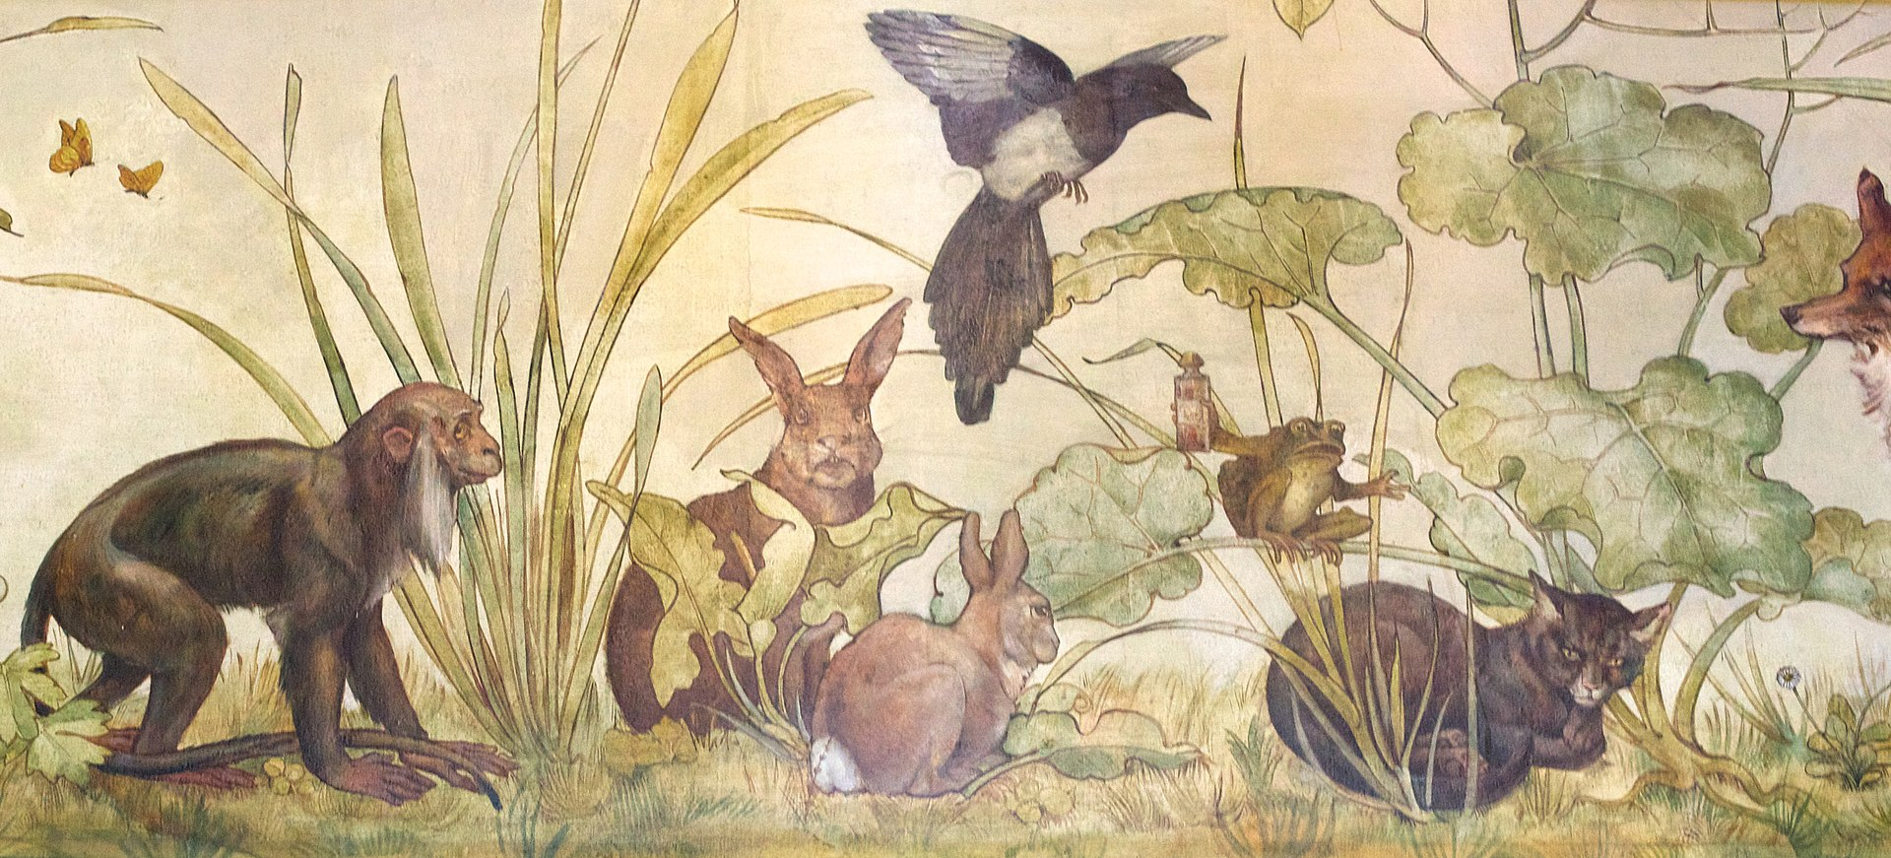
What’s the Moral of the Story?
Extracting Moral Themes from Folktales
via Large Language Model GPT-J
Cassady Shoaff
M.S. Computational Linguistics
Advisor:
Dr. Anna Feldman

Slide 2

Motivation: AI Safety
Public anxieties towards AI language models reflect real concerns about possible future existential risk caused by superintelligent AI.
Although this threat remains in the realm of science fiction, recent controversy such as the termination of Google software developer Blake Lemoine due to his conviction that the LaMBDA model had gained sentience (Wertheimer 2021) highlights the public’s intuition that large language models may pose a potential threat.
One proposed method of mitigating existential risk from AI is alignment, or aligning the goals of AI with human values.
(Sezener 2015, Hendrycks 2020)
Notes:
Addressing the possibility of future endangerment wrought by AI agents is of current interest in AI safety research.

Slide 3
Motivation: Stories Teach Moral Values
Morality is subjective. Even human beings do not agree on human values.
Yet, somehow everyone manages to learn something about morality.
One way to teach positive values to children is through literature. (Francis 2018, Leming 2000)
Aesop’s Fables are a widely-known traditional collection of children’s stories that have remained popular since ancient Greece.
Each fable has an explicitly stated moral lesson at the end.
Can a language model learn the same moral lesson?

Slide 4
Data: Fables & Folktales Corpora
Traditional short stories, usually for children, that often express a moral lesson or cultural value.
Dataset 1: Aesop's Fables, by J. H. Stickney from Project Gutenberg
Thanks to Itay Niv on GitHub for Aesop’s Fables in JSON format.
Dataset 2: Global Folktales of 57 Nations
Thanks to Andrzej Panczenko for folktales collection in CSV format.
Open Data Commons Open Database License (ODbL) v1.0

Slide 5
Data: Preprocessing using Python pandas
Aesop’s Fables
Mean word count: 164 Maximum word count: 430
Mean character length: 838 Maximum character length: 2207
Global Folktales
Mean word count: 1828 56 nations (removed Greece to avoid Aesop overlap)
Since the average folktale is much longer than an Aesop, must filter out overly-long texts.
Filtered folktales with a maximum word count of 400 since most Aesop’s fables are <400 words. Left with 375 folktales under 400 words.

Slide 6
Model: GPT-J-6B
Wang & Komatsuzaki (2021)
Created by Ben Wang and Aran Komatsuzaki from EleutherAI
GPT stands for generative pre-trained transformer
6 billion parameter, autoregressive text generation model
J refers to the JAX mesh used to speed up model training
Notes:
6B trainable parameters
The model consists of 28 layers with a model dimension of 4096, and a feedforward dimension of 16384. The model dimension is split into 16 heads, each with a dimension of 256. Rotary Position Embedding (RoPE) is applied to 64 dimensions of each head.
A transformer is a deep learning model with self-attention

Slide 7
Model: GPT-J-6B
Same tokenizer as GPT-2/3 (Radford 2019)
Trained on The Pile (400B tokens dataset with 800GB text)
Uses cross-entropy loss to maximize the likelihood of predicting the next token (left-to-right text generation)
Reached similar benchmarks to OpenAI’s 6.7B GPT-3 Curie

Slide 8
Model: Why GPT-J?
Hugging Face API access easily available: no need to self-host
GPT-J’s input sequence accepts 2048 tokens, so several fables are able to fit into the model’s input prompt (vs. other models with smaller input sequences)
Other LLMs were considered, but decided against due to their smaller input sequence limit, such as T5 with 512 maximum sequence tokens and BART with 1024 tokens.

Slide 9
Model: Why GPT-J?
LLMs are frequently used for text summarization tasks (Gupta 2022, Adhikari 2020, Zhang 2019)
→ This project treats the moral lesson as a specific type of summary.
Few-Shot Learning:
The model is prompted with several samples of the task, then left to complete the task (generate appropriate text) on the final entry of the prompt.

Slide 10
Compute Resources
Data Storage: Google Drive
Environment: JupyterLab via Google Colaboratory
GPU via Colab Pro: NVIDIA-SMI 460.32.03
Model: EleutherAI’s GPT-J-6B hosted by Hugging Face
Hugging Face Pro: Increased allowance of API requests for GPT-J
Python libraries: Pandas, Transformers, BERTscore, BLANC

Slide 11
Clarification: What do we mean by ‘moral’?
moral
noun
the moral significance or practical lesson (as of a story)
a passage pointing out usually in conclusion the lesson to be drawn from a story
“Moral.” Merriam-Webster.com Dictionary, Merriam-Webster, https://www.merriam-webster.com/dictionary/moral. Accessed 15 Dec. 2022.

Slide 12
Experiment 1: Aesop’s Fables
Research Question:
Given several examples of short stories with moral lessons at the end,
can the model learn to generate the moral for another short story?
Few-Shot Learning Method:
Prompt the model with several examples of a story and its moral lesson.
On the last story, leave the moral blank for the model to generate.

Slide 13
Experiment 1: Prompt Construction
Concatenate the full story text of 3 fables, complete with their original morals
prefixed by Moral: and ending with an end token ### separating the texts.
Then concatenate the 4th fable text alone, ending with the Moral: prefix to indicate where the model should fill in the blank.
Storytext1 Moral: Moral1 ### Storytext2 Moral: Moral2 ### Storytext3 Moral: Moral3 ### Storytext4 Moral:

Slide 14
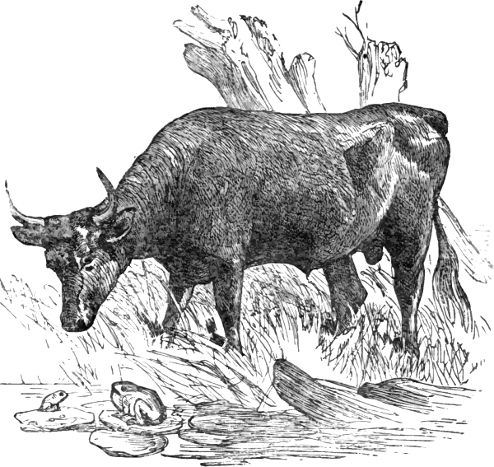
The Frog and the Ox
Notes:
An Ox came down to a reedy pool to drink. As he splashed heavily into the water, he crushed a young Frog into the mud. The old Frog soon missed the little one and asked his brothers and sisters what had become of him. A great big monster, said one of them, stepped on little brother with one of his huge feet! Big, was he! said the old Frog, puffing herself up. Was he as big as this? Oh, much bigger! they cried. The Frog puffed up still more. He could not have been bigger than this, she said. But the little Frogs all declared that the monster was much, much bigger and the old Frog kept puffing herself out more and more until, all at once, she burst.

Slide 15
The Frog and the Ox
An Ox came down to a reedy pool to drink. As he splashed heavily into the water, he crushed a young Frog into the mud. The old Frog soon missed the little one and asked his brothers and sisters what had become of him. A great big monster, said one of them, stepped on little brother with one of his huge feet! Big, was he! said the old Frog, puffing herself up. Was he as big as this? Oh, much bigger! they cried. The Frog puffed up still more. He could not have been bigger than this, she said. But the little Frogs all declared that the monster was much, much bigger and the old Frog kept puffing herself out more and more until, all at once, she burst.
Notes:
An Ox came down to a reedy pool to drink. As he splashed heavily into the water, he crushed a young Frog into the mud. The old Frog soon missed the little one and asked his brothers and sisters what had become of him. A great big monster, said one of them, stepped on little brother with one of his huge feet! Big, was he! said the old Frog, puffing herself up. Was he as big as this? Oh, much bigger! they cried. The Frog puffed up still more. He could not have been bigger than this, she said. But the little Frogs all declared that the monster was much, much bigger and the old Frog kept puffing herself out more and more until, all at once, she burst.

Slide 16
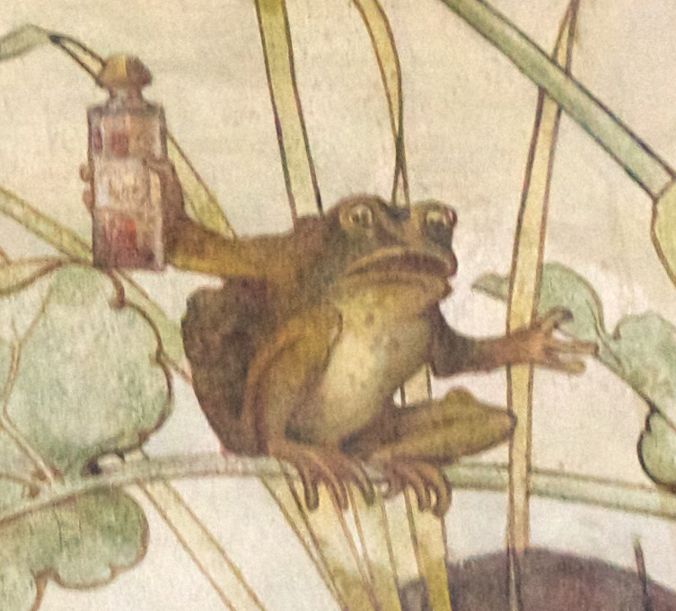
Original
moral:
Do not attempt the impossible.

Slide 17
GPT-J
generated:
Do not puff yourself up.

Slide 18
Experiment 1: Full Response Example
A Rat was traveling along the King's highway. He was a very proud Rat, considering his small size and the bad reputation all Rats have. As Mr. Rat walked along, he kept mostly to the ditch, he noticed a great commotion up the road, and soon a grand procession came in view. It was the King and his retinue. The King rode on a huge Elephant adorned with the most gorgeous trappings. With the King in his luxurious howdah were the royal Dog and Cat. A great crowd of people followed the procession. They were so taken up with admiration of the Elephant, that the Rat was not noticed. His pride was hurt. What fools! he cried. Look at me, and you will soon forget that clumsy Elephant! Is it his great size that makes your eyes pop out? Or is it his wrinkled hide? Why, I have eyes and ears and as many legs as he! I am of just as much importance, and But just then the royal Cat spied him, and the next instant, the Rat knew he was not quite so important as an Elephant. Moral: A resemblance to the great in some things does not make us great. ### Some Boys were playing one day at the edge of a pond in which lived a family of Frogs. The Boys amused themselves by throwing stones into the pond so as to make them skip on top of the water. The stones were flying thick and fast and the Boys were enjoying themselves very much; but the poor Frogs in the pond were trembling with fear. At last one of the Frogs, the oldest and bravest, put his head out of the water, and said, Oh, please, dear children, stop your cruel play! Though it may be fun for you, it means death to us! Moral: Children should be taught to be kind, and not cruel.
Notes:
Original Aesop: Always stop to think whether your fun may not be the cause of another's unhappiness.
(omitted first three fables to fit on the slide)

Slide 19
Experiment 1: Resolving Complications
Sometimes, GPT-J left the moral blank.
The temperature parameter limits the model from generating improbable output.
Increasing temperature allows more randomness in the output text.
Higher temperature = more random. Colloquially the “creativity setting”
🌡️ Initial run used temperature 0.5
GPT-J generated morals for all but 38 fables.
🌡️↑ Temperature increased to 0.7 for more flexibility
Generated morals for all but 6.
🌡️↑↑ A further increase to temperature 0.8
Generated morals for the entirety of Aesop’s fables.

Slide 20
Experiment 1: Extracting the Generated Morals
Model response includes the entire text of the prompt → need to filter
Generated moral appears at the end of the response, between the prefix Moral: and end token ###
Use Regular Expressions [RegEx]
Search the last 500 characters of the response (to avoid the original morals)
Capture the text between the prefix and end token
Stored in a Pandas DataFrame alongside story text, original moral, full response for reference, and then exported to CSV spreadsheet

Slide 21
Experiment 1: Human Evaluation: Annotation Task
Three annotators from MSU NLP Lab completed the following two-part annotation task.
Please compare moral 1 and moral 2, then answer the following question:
Do moral 1 and moral 2 express more-or-less the same meaning? [Yes/No]
If you answered No: Please read the corresponding story, then answer:
Does moral2 make sense with the context? [Yes/No]
Moral 1 was the original moral provided by the story’s author of the fable.
Moral 2 was the moral generated by GPT-J.
Instructions did not reveal to the annotators which was which (although they might infer)

Slide 22
Experiment 1: Agreement Between Annotators
Observed agreement was calculated by summing the number of exact matches between annotators, divided by total ratings.
Observed Agreement
Q1 | 64% | Q2 | 42%
Cohen’s Kappa
Q1_A1_A2 | 0.285 | Q2_A1_A2 | 0.157
Q1_A1_A3 | 0.237 | Q2_A1_A3 | 0.368
Q1_A2_A3 | 0.314 | Q2_A2_A3 | 0.270
Cohen’s Kappa was calculated via Scikit-learn discern whether consensus had occurred by chance.
0.1 – 0.20 indicates slight agreement. 0.21 – 0.40 indicates fair agreement.
Notes:
0 = agreement equivalent to chance. 0.1 – 0.20 = slight agreement. 0.21 – 0.40 = fair agreement.
Thank you to Jordan Thomas, Nick Hankins, and Zach Schultz
Q1_A1_A2 0.285
Q1_A1_A3 0.237
Q1_A2_A3 0.314
Q2_A1_A2 0.157
Q2_A1_A3 0.368
Q2_A2_A3 0.270

Slide 23
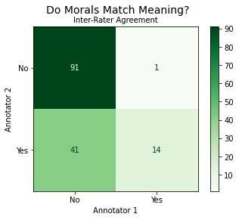
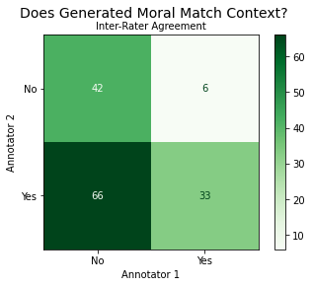
Experiment 1: Inter-Rater Agreement, A1 & A2
Notes:
Visualizations were created via Python Scikit-learn and Matplotlib PyPlot.
a1 JThomas
a2 NHankins

Slide 24
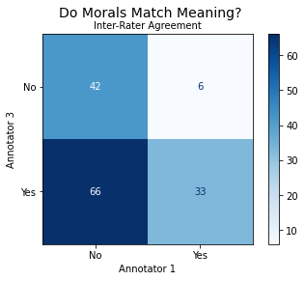
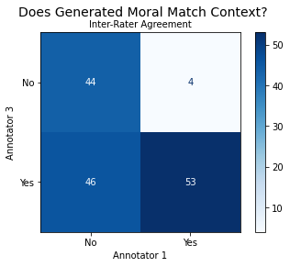
Experiment 1: Inter-Rater Agreement, A1 & A3
Notes:
Visualizations were created via Python Scikit-learn and Matplotlib PyPlot.
a1 JThomas
a3 ZSchultz

Slide 25
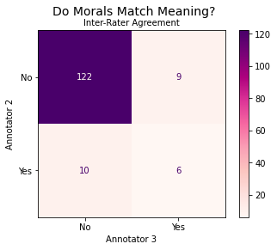
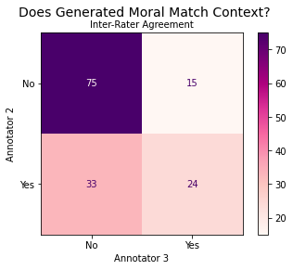
Experiment 1: Inter-Rater Agreement, A2 & A3
Notes:
Visualizations were created via Python Scikit-learn and Matplotlib PyPlot.
a2 NHankins
a3 ZSchultz

Slide 26
Experiment 1: Computational Evaluation: BERTscore
BERTscore evaluated the resemblance between the original and generated morals
Maximizes the cosine similarity between contextualized token embeddings from BERT. Shown to correlate well with human judgment (Zhang 2019)
Mean F1-score of 73%
Generated morals were fairly similar to the originals in embeddings
Notes:
The F1 score is the harmonic mean of the precision and recall.
calculated from the precision and recall of the test, where the precision is the number of true positive results divided by the number of all positive results, including those not identified correctly, and the recall is the number of true positive results divided by the number of all samples that should have been identified as positive.

Slide 27
Experiment 1: Computational Evaluation: BLANC
BLANC score is a reference-free summarization evaluation tool developed to avoid the need for a ‘gold-standard’ reference sentence (Vasilyev 2020)
Masks sections of input with pieces from the summary, compared to filler
range from -1 to 1, typical values are between 0 (useless) and 0.3 (30% help)
According to these BLANC scores, the morals do a poor job of summarizing the texts.
Although scores are close to useless, because we regard the original as the ‘gold standard’ this still provides a useful baseline for comparison in the next experiment.
Original Moral / Generated Moral | 0.02461
Context Fable / Original Moral | 0.00127
Context Fable / Generated Moral | 0.01178
Notes:
BLANC value can range from -1 to 1, but as shown in next sections the typical values are between 0 (summary is useless) and 0.3 (summary provides 30% help).
We define BLANC-help as the difference between the accuracy As of unmasking with the summary and the accuracy Af of unmasking with the filler (Vasilyev 2020)

Slide 28
Experiment 1: Syntactic Style: Association Rules
Annotators noted that the model successfully mimicked the correct style.
Part of speech patterns in the original and generated morals were examined with association rules mining via apriori algorithm, using NLTK and apyori Python libraries. The part of speech tagger used the UPenn Treebank tagset.
Apriori algorithm discovers which items are associated with each other: in this case, which parts of speech sequences appear among morals.

Slide 29
Experiment 1: Syntactic Style: Association Rules
The parameters were minimum support of 0.05, minimum confidence of 0.2, and minimum lift of 3. The part of speech patterns common to both original and generated morals were as follows:
('TO', 'DT', 'VB', 'VBZ', 'NN')
('TO', 'DT', 'VB', 'VBZ', 'PRP')
('TO', 'IN', 'VB', 'VBZ', 'PRP')
('TO', 'VB', 'VBZ', 'NN', 'PRP')
('TO', 'DT', 'VB', 'VBZ', 'NN', 'PRP')
('RB', 'TO', 'DT', 'VB', 'VBZ', 'NN')
('TO', 'IN', 'VB', 'VBZ', 'NN', 'PRP')
Notes:
To be wise, you must know how to laugh at yourself.

Slide 30
Experiment 2: From Fables to Folktales
Research Question:
Can the same technique to generate morals be applied to folktales from diverse cultural backgrounds that never had an original moral ascribed by the author?
Few-Shot Learning:
Prompt the model with several Aesop’s Fables and their original moral lesson.
On the last story, use a folktale that never had a moral from the original author.
Leave the moral blank for the model to generate.

Slide 31
Experiment 2.1: Random Seed Stories
Prompt constructed from two fables complete with morals randomly chosen from the 147 Aesop’s Fables (random seed stories).
Only two were used instead of four as in experiment 1 because most of the folktales are longer than an Aesop’s Fable, even after filtering out any texts over 400 words.
Default temperature setting 0.5
GPT-J was able to generate morals for 280 of 375 folktales.

Slide 32
Experiment 2.2: Good Seed Stories
Process repeated, but rather than randomly selecting the seed stories from all 147 of Aesop’s Fables to construct the prompt, only ‘good seeds’ i.e. those that all three annotators agreed had generated a moral which matched the context fable, were randomly chosen as prompts for the second round of the experiment.
On this run, the model generated 302 morals for 375 folktales.
When the two runs are combined, there were 225 folktales with two versions of the generated morals for comparison.

Slide 33
Experiment 2: Evaluation: BLANC
Without an original moral to act as the ‘gold standard’ summary, evaluation is very difficult. BLANC score was calculated, but is close to zero (useless), however the scores do resemble those from Experiment 1, and good seeds do slightly better.
Fables
Original / Generated | 0.02461
Fable / Original | 0.00127
Fable / Generated | 0.01178
Folktales
GoodSeed / RandomSeed | 0.05392
Folktale / RandomSeed | 0.00142
Folktale / GoodSeed | 0.00253

Slide 34
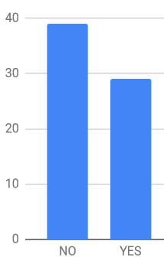
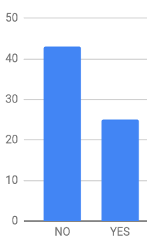
Experiment 2: Annotation (Ongoing) *pardon the mess
Annotation Task: [YES/NO]
Does each moral answer the question, ‘What is the moral of the story?’
A1 GoodSeed NO 39 YES 29
A1 RandomSeed NO 43 YES 25
Most generated morals for the folktales don’t match the context well, but the ones generated using only the good seed stories do slightly better.
Notes:
Sorry these are a bit rough and ready. Snipped from google sheets column stats.

Slide 35
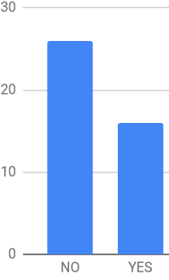
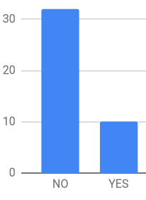
Experiment 2: Annotation (Ongoing)
Annotator 2 is a librarian.
A2 GoodSeed NO 26 YES 16
A2 RandomSeed NO 32 YES 10
Again, the morals don’t match, but the good seeds seem to do slightly better.

Slide 36
Experiment 2: Examples
Context: Folktale about abusive tailor who goes to jail for domestic violence and does not change his behavior after he is released from prison. At the end of the story, the judges ‘gave him the reward he deserved,’ meaning he is punished.
RandomSeed Moral:
We are not to be too hard on those who transgress against us, for they are not to blame.
Obviously this is not an acceptable moral lesson for this folktale.
GoodSeed Moral:
We should not beat our wives, but should rather love them and share joy and sorrow with them.
This moral is highly specific and relevant to the story. In fact, the actual title of this German folktale is ‘Sharing Joy and Sorrow.’ (The stories’ titles were never shown to the model.)

Slide 37
Experiment 2: More Examples
A little bit of fun is better than a lot of work.
The brave man is not he who bears a shield and arms, but he who bears himself bravely.
A word spoken in anger is like a blow from a fist, and the tongue is like a blade.
The race is not always to the swift, nor the battle to the strong, but that is the way to bet.
The true way to a man’s heart is through his conscience.
If you wish to be happy, be honest.

Slide 38
Experiment 2: Observations
Many of the folktales in the second dataset appear to lack any lesson about moral values, aiming instead to provide a folk explanation of some phenomenon in the natural world, or to simply entertain.
Where a human reader would struggle to articulate the lesson to be learned from the text, the model tends to struggle also. Hence, many of the generated morals here are not particularly relevant to the context tale.
The model especially struggles with the texts that are written in rhyme, likely because GPT-J’s training data was mainly prose text.

Slide 39
Conclusion
By using few-shot learning to prompt large language model GPT-J with several examples of an Aesop’s Fable alongside its corresponding original moral, GPT-J generated morals that have the correct style, although they do not always properly suit the context.
When using Aesop’s Fables as few-shot examples, but changing the final text to a folktale that lacked an original moral from the author, GPT-J was also able to mimic the appropriate style, but often failed to generate a relevant moral.

Slide 40
Future Work
Need more reference-free metrics for evaluating summarization.
Difficult to find an easily applicable working implementation.
Treating the morals as a specific type of summary doesn’t really work…
Try considering it a machine reading comprehension task instead.
Jiao 2021, De La Rosa 2022
Find another corpus of children’s tales that have morals written by the author.
Lemming 2000 discusses such a collection, but the stories are not public domain
Exclude violent folktales and any content that would no longer be considered appropriate for children from the folktales corpus
If a larger corpus were available, fine-tuning would become an option.
The model might be able to perform better with pre-training on enough examples

Slide 41
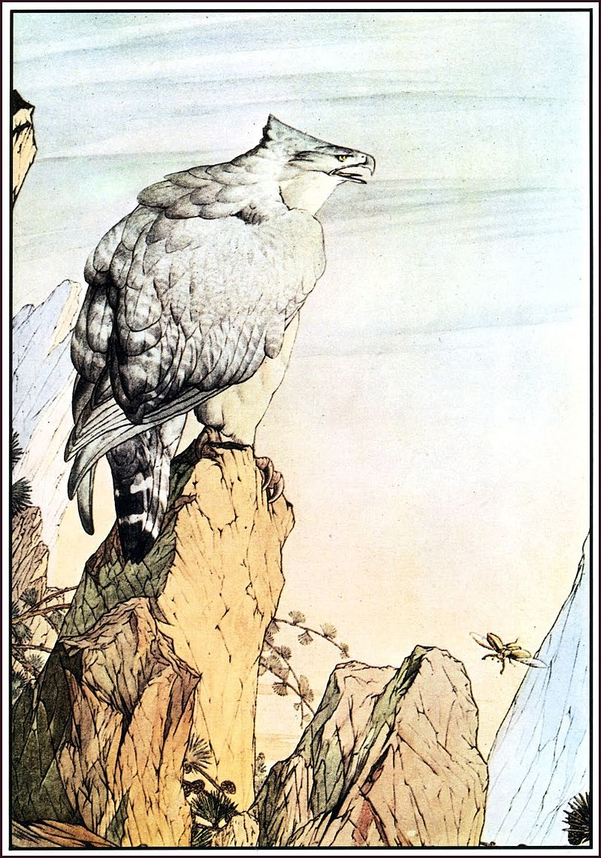
Acknowledgements
Thank you to my advisor, Dr. Anna Feldman, and everyone in the NLP Lab for their invaluable feedback, especially Dr. Peng, and all your advice and support these two years.
Special thanks to all my annotators, including Dr. Feldman, Jordan Thomas, Nick Hankins, Zach Schultz, and MJ Spitzer.
Notes:
Plate from "The Fables of Aesop", "The Eagle and the Beetle", 1909 Edward Julius Detmold

Slide 42
References
Zhang, T., Kishore, V., Wu, F., Weinberger, K., & Artzi, Y. (2019). Bertscore: Evaluating text generation with bert. arXiv preprint arXiv:1904.09675.
Wang, B., & Komatsuzaki, A.. (2021). GPT-J-6B: A 6 Billion Parameter Autoregressive Language Model.
Pedregosa, F., Varoquaux, G., Gramfort, A., Michel, V., Thirion, B., Grisel, O., Blondel, M., Prettenhofer, P., Weiss, R., Dubourg, V., & others (2011). Scikit-learn: Machine learning in Python. Journal of machine learning research, 12(Oct), 2825–2830.
Hunter, J. (2007). Matplotlib: A 2D graphics environment. Computing in science & engineering, 9(3), 90–95.
Radford, A., Wu, J., Child, R., Luan, D., Amodei, D., Sutskever, I., & others (2019). Language models are unsupervised multitask learners. OpenAI blog, 1(8), 9.
Vasilyev, O., Dharnidharka, V., & Bohannon, J. (2020). Fill in the BLANC: Human-free quality estimation of document summaries. arXiv preprint arXiv:2002.09836.
Mendes, A., & Antunes, C. (2009). Pattern mining with natural language processing: An exploratory approach. In International Workshop on Machine Learning and Data Mining in Pattern Recognition (pp. 266–279).
Rahman, C., Sohel, F., Naushad, P., & Kamruzzaman, S. (2010). Text classification using the concept of association rule of data mining. arXiv preprint arXiv:1009.4582.
Zhang, Xingxing, Furu Wei, and Ming Zhou. "HIBERT: Document level pre-training of hierarchical bidirectional transformers for document summarization." arXiv preprint arXiv:1905.06566 (2019).
Adhikari, Surabhi. "Nlp based machine learning approaches for text summarization." 2020 Fourth International Conference on Computing Methodologies and Communication (ICCMC). IEEE, 2020.
Gupta, Anushka, Diksha Chugh, and Rahul Katarya. "Automated news summarization using transformers." Sustainable Advanced Computing. Springer, Singapore, 2022. 249-259.

Slide 43
References
Gao, Leo, et al. "The pile: An 800gb dataset of diverse text for language modeling." arXiv preprint arXiv:2101.00027 (2020).
Hendrycks, Dan, et al. "Aligning ai with shared human values." arXiv preprint arXiv:2008.02275 (2020).
Leming, James S. "Tell me a story: An evaluation of a literature-based character education programme." Journal of Moral Education 29.4 (2000): 413-427.
Francis, Leslie J., et al. "Evaluating the pilot Narnian Virtues Character Education English Curriculum Project: a study among 11-to 13-year-old students." Journal of Beliefs & Values 39.2 (2018): 233-249.
Irving, Geoffrey, and Amanda Askell. "AI safety needs social scientists." Distill 4.2 (2019): e14. AI Safety Needs Social Scientists
Sezener, C.E. (2015). Inferring Human Values for Safe AGI Design. In: Bieger, J., Goertzel, B., Potapov, A. (eds) Artificial General Intelligence. AGI 2015. Lecture Notes in Computer Science(), vol 9205. Springer, Cham. https://doi.org/10.1007/978-3-319-21365-1_16
Sarma, G.P., Hay, N.J., Safron, A. (2018). AI Safety and Reproducibility: Establishing Robust Foundations for the Neuropsychology of Human Values. In: Gallina, B., Skavhaug, A., Schoitsch, E., Bitsch, F. (eds) Computer Safety, Reliability, and Security. SAFECOMP 2018. Lecture Notes in Computer Science, vol 11094. Springer, Cham. https://doi.org/10.1007/978-3-319-99229-7_45
Wertheimer, T. (2021, July 23). Blake Lemoine: Google fires engineer who said AI tech has feelings. BBC News. Retrieved from https://www.bbc.com/news/technology-62275326.
Muehlhauser, Luke, and Louie Helm. "The singularity and machine ethics." Singularity Hypotheses. Springer, Berlin, Heidelberg, 2012. 101-126.
Jiao, Fangkai, et al. "Rept: Bridging language models and machine reading comprehension via retrieval-based pre-training." arXiv preprint arXiv:2105.04201 (2021).
All illustrations are in the public domain.

Slide 44
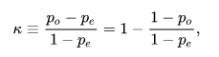
Cohen’s Kappa Formula
Notes:
where po is the relative observed agreement among raters, and pe is the hypothetical probability of chance agreement, using the observed data to calculate the probabilities of each observer randomly seeing each category. If the raters are in complete agreement then κ = 1 {\textstyle \kappa =1}. If there is no agreement among the raters other than what would be expected by chance (as given by pe), κ = 0 {\textstyle \kappa =0}.

